Slide 1
Cyber Maturity model

Slide 2

Structure and Evolution of Malware Defense
Governance, Risk and Compliance
Triage and Response (SOC/IR)
Controls and Tools (Engineering)
Cyber Maturity Levels
Level 4-5
Level 2.5-5
Level 0-5

Slide 3
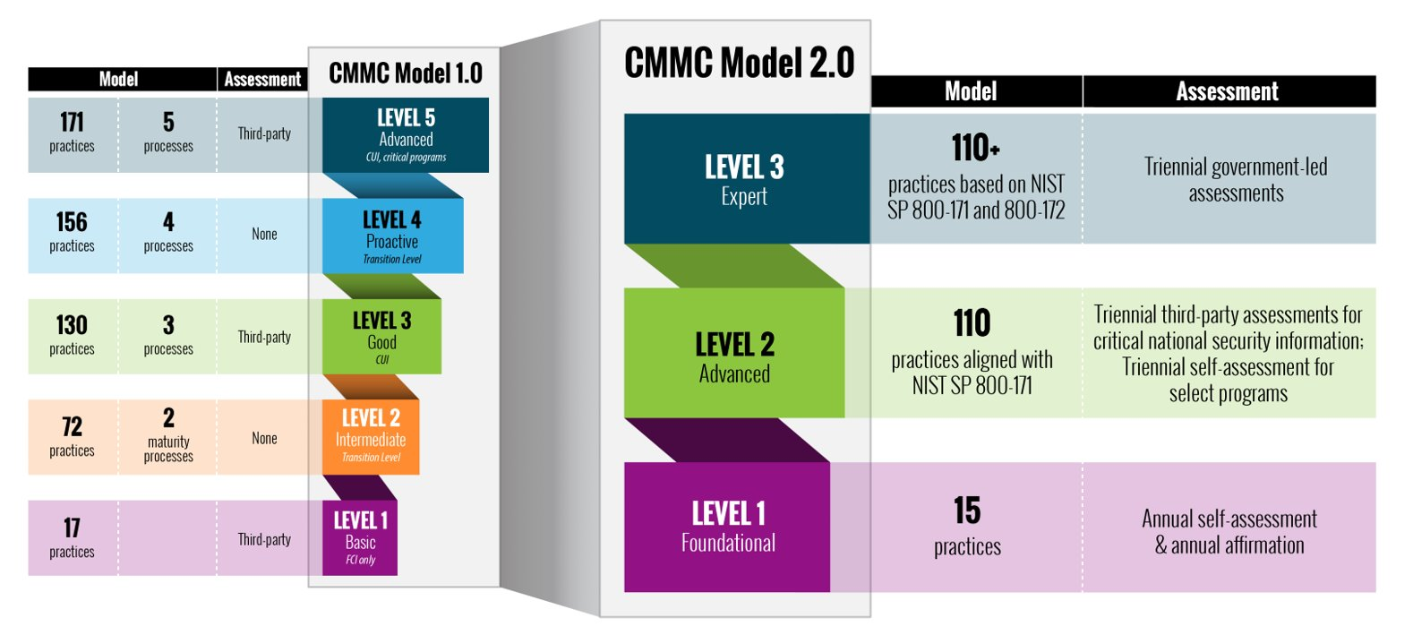
Cybersecurity Maturity Model Certification
https://www.cisa.gov/resources-tools/resources/cybersecurity-maturity-model-certification-20-program

Slide 4
Defensive Strategy (Malware and Intrusion)
Tools and Engineering of Solutions
Deploy initial foundational defensive controls.
Create detective controls and build up security intelligence (IDS/NDR/SIEM/SOAR).
Define and implement vulnerability management, host and environment hardening strategy.
SOC, IR, Threat Hunting, Purple Teaming
Implement SOC including basic triage in alignment with desired coverage model.
Evolve robust Incident Response capabilities and put these experts to work on threat hunting and continuous assessment when there is not an incident.
GRC
Everyone starts with the “C” but true Governance and Risk Management are elusive disciplines that represent an advanced skillset most organizations lack.
Research
Advanced disciplines that cultivate understanding of threats, vulnerabilities, control adjustments and response strategies tend to roll up to the category of security research.

